Slide 1
Predicting distress under the outbreak of COVID-19
SOWK 3136 - Group A
CHEUNG Lap Wai
LU Yuk Ho
TANG Ming Chun
TSUI Wing Tung
3035869481
3035762554
3035659290
3035730070

Slide 2
CONTENTS
01
02
03
04
INTRODUCTION
METHODS
RESULTS
DISCUSSION

Slide 3
01
INTRODUCTION
Theoretical Background | Objectives | Hypotheses | Significances

Slide 4
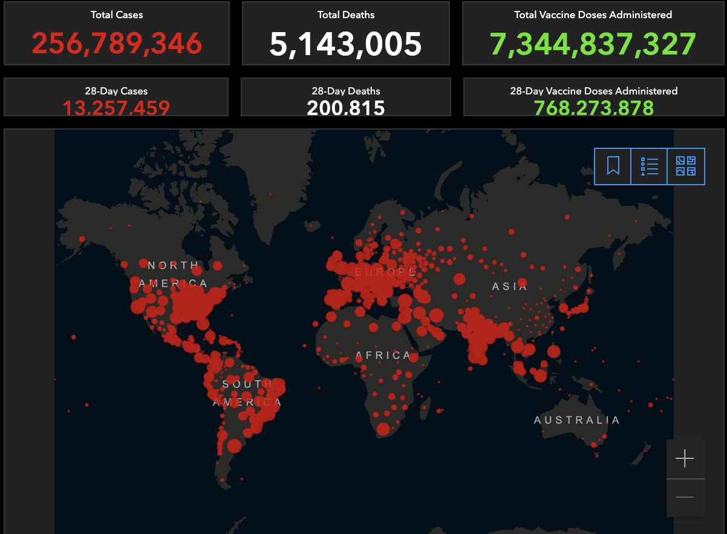
How’s COVID-19?

Slide 5
The Global Mental Crisis
Average global pooled prevalence of psychological distress significantly rose from 24% to 66%
Meta-analyses about global prevalence of mental disorders during COVID-19:
Depression prevalence ranging from 7.45% to 48.3%
Pooled prevalence: 25% (during COVID-19) v.s. 3.44% (2017)
Anxiety prevalence is ranging from 6.33% to 55.5%
Pooled prevalence: 25% (during COVID-19) v.s. 7.3% (2017)
Psychological distress
The combined affective domains of major depressive disorder and generalized anxiety disorder
Consequences
Substance abuse
Occupational dysfunction
Interpersonal relationship dysfunction
Dysfunctional decision-making process
Loss/reward system malfunction
Predict various emotional disorders (depression, anxiety, MADD)
(Liu et al., 2021)
(Kessler et al., 2002)
(Hardy et al., 2003; Kessler et al., 2002; Lechner et al., 2020; Lee et al., 2001; Wells et al., 1999)
(Bueno-Notivol et al., 2021; Santabárbara et al., 2021)

Slide 6
What are used to predict DISTRESS under COVID-19?

Slide 7
Covid Conditions
Number of new cases and new deaths
Perception about likelihood of getting infected and death from COVID-19
Introduce life threat toward self and significant others
Pandemic-related primary stressors
Concern over covid
Heightened attention towards threat
Covid-related health anxiety
Media
Media and rumors induce fear over the city
Ambiguous message → increase fear and escalate the desire for facts
Attend to more sources and unreliable sources → induce fear and distress
(Holingue et al., 2020; Zheng et al., 2021)
(Wheaton et al., 2021)
(Rubin & Wessely, 2020)

Slide 8
Government Policies
Trust in Government
Closing Policies
Boredom
Losing sense of meaning of life
Heightened stress and distress
Healthcare Policies
Covid-related health anxiety
Privacy issues
Increase stress and distress
Economic policies
Relieve financial burden
Reduce Covid-related secondary stressors
Trust in preventive measures & health system
Negative association between trust in healthcare measures and distress
↑ reliance on reliable source of health information
↓ health anxiety
Medically vulnerable group with low trust show greatest distress
Moderate the positive relationship between tight policies and distress
(Chao et al., 2021)
(Burke et al., 2020)
(Harris & Sandal, 2021; O’Hara et al., 2020)
(Duarte & Jiménez-Molina, 2021)

Slide 9
Personal Traits
Coping Resources
Personality
Neuroticism → distress, health anxiety
Extraversion, agreeableness, conscientiousness, openness negatively correlated with distress
Compliance with guidelines
Compliance predict distress
Health information avoidance
Trust in people
Interpersonal trust as protective factor
Distrust → social avoidance & distress
Perceived social support
Negatively associated with distress
Buffer the worry about COVID-19 and health
Coping style
Active problem-focused coping, and distractions (avoidance) associate with lower level of distress
Various kinds of coping strategies are helpful in reducing distress
Only substance coping predict distress
(El‑Zoghby et al., 2020; SzKody et al., 2021)
(Nikčević et al., 2021)
(Siebenhaar et al., 2020)
(Nielsen & Knardahl, 2014; Park et al., 2021)
(Goodwin et al., 2020; Yang et al., 2009)

Slide 10
Demographics
Age
Negative association between age & distress during COVID-19
Younger people → larger social needs
Gender
Female are more prone to distress
Marital status
Cohabiting or married have less distress than never married
Provide emotional support during critical time
Educational level (self and parents)
Education is a protective factors
Parents’ education negatively predict child’s distress
Less COVID-related
Employment status
Unemployed, self-employed, and unpaid leave with absence
Employment uncertainty → distress
Number of dependent(s)
Financial needs & family infection concern
↑ difficulty of working from home
(Varma et al., 2021)
(Chen et al., 2020; Romeo et al., 2021; Thompson Jr et al., 1993)
(Liu et al., 2021)
(Achdut & Refaeli, 2020; Mimoun et al., 2020)
(Hearne et al., 2021)
(Kowal et al., 2020)

Slide 11
Life Influences
Risk for infection
Near the epicenter of the pandemic because of geographical and occupational reasons
Greater Covid-related health anxiety and distress
Perceived isolation
Induce loneliness that predict psychological distress and various mental disorders
Restrict access to social support
Step token to avoid infecting others, and infected by others → distress
(Qiu et al., 2020; Wang et al., 2020)
(Holingue et al., 2020; Saltzman et al., 2020; Varma et al., 2021)

Slide 12
Research Gaps
Although various distress predictors under COVID-19 are identified, their relative contributions remain unexplored
Include many predictors in a single model for comparisons
Many studies are conducted in small sample size with snowball sampling within a country
→ unrepresentative, contradicting, and biased results
e.g. Sibley et al. (2020) report institutional trust positively associated with distress
Global research with large sample size
Lack of study compares the predictive performance of different predictive models for distress predictors under COVID-19
Comparisons between predictive models under global context

Slide 13
Objectives
To test the predictive power of CovidiStress and covidpolicy variables
To test the predictive performance of linear regression, classification and regression trees, random forest, support vector machine (svm), and xgboost in predicting distress comprehensively
To identify the optimal predictive model that can be applied globally and provide suggestions with early mental symptoms

Slide 14
Hypotheses
Stress and loneliness are the most significant predictors of distress under COVID-19
XGBoost has the highest predictive accuracy among the models

Slide 15
Significances
Theoretical significances
Unveil the relative contributions of distress among predictors
Gain insights into the distress predictors that are applicable across countries and cultures
Identify the ideal model for predicting distress under COVID-19
Provide insights about the psychological impacts of collective trauma
Practical significances
Allow early identification of vulnerable groups towards mental disorders
Allow more cost-effective interventions by targeting the most significant predictors
Provide insights into self-help programs
Inform policy makers about the potential hidden threats of implementing different policies related to COVID-19

Slide 16
METHODS
02
Data Source | Variables of Interest | Analytical Procedure

Slide 17
Data Source
COVIDISTRESS Global survey dataset (Yamada et al., 2021)
Period: 30 March to 30 May 2020
Sampling: online and media appeals
No. of features: 29
Demographic variables
Emotional responses
Attitudes
Coping resources
Oxford COVID-19 Government Response Tracker (Hale et al., 2021)
Period: since 1st January 2020
Sampling: Rated by OxCGRT by collecting information from governments of different countries
No. of features: 16
Cases and deaths statistics
Confinement and closing policies
Economic policies
Health policies
Notes:
The OxCGRT systematically collects information on several different common policy responses governments have taken, records these policies on a scale to reflect the extent of government action, and aggregates these scores into a suite of policy indices.

Slide 18
Independent variables
Emotional responses | Perceived stress (Perceived stress scale) | Trust in government | Trust in health system (OECD trust)
 | Perceived loneliness (Scale of loneliness) |  | Trust in preventive measures (OECD trust)
Personal traits | Big five personality (Big Five Inventory-short) | Coping resources | Social provision (social provision scale)
 | Compliance with guidelines & restrictions (6-item original scale) |  | Problem-focused coping (16-item original scale)
 | Trust in people (OECD trust) |  | Social contact coping (16-item original scale)
Geographical location | Country |  | Avoidance coping (16-item original scale)
 |  |  | Religion coping (16-item original scale)

Slide 19
COVID conditions | New cases | Demographics | Age
 | New deaths |  | Gender
 | Concern over COVID-19 (5-item original scale) |  | Country
 | Media (6-item original scale) |  | Marital status
Life influences | High risk group (1-item yes/no/not sure) |  | Employment status
 | Perceived isolation (1-item original scale) |  | Educational level
 |  |  | Maternal educational level
 |  |  | Number of dependents

Slide 20
Confinement and closing policies | School closing | Economic policies | Income support
 | Workplace closing |  | Debt/contract relief
 | Cancel public events | Health policies | Public information campaigns
 | Close public transport |  | Testing policies
 | Stay at home requirement |  | Contact tracing
 | School closing |  | Facial covering
 | Restrictions on internal movement |  | Vaccination policies
 | International movement controls |  | Protection of elderly people
Dependent variable
Distress (13-item original scale)

Slide 21
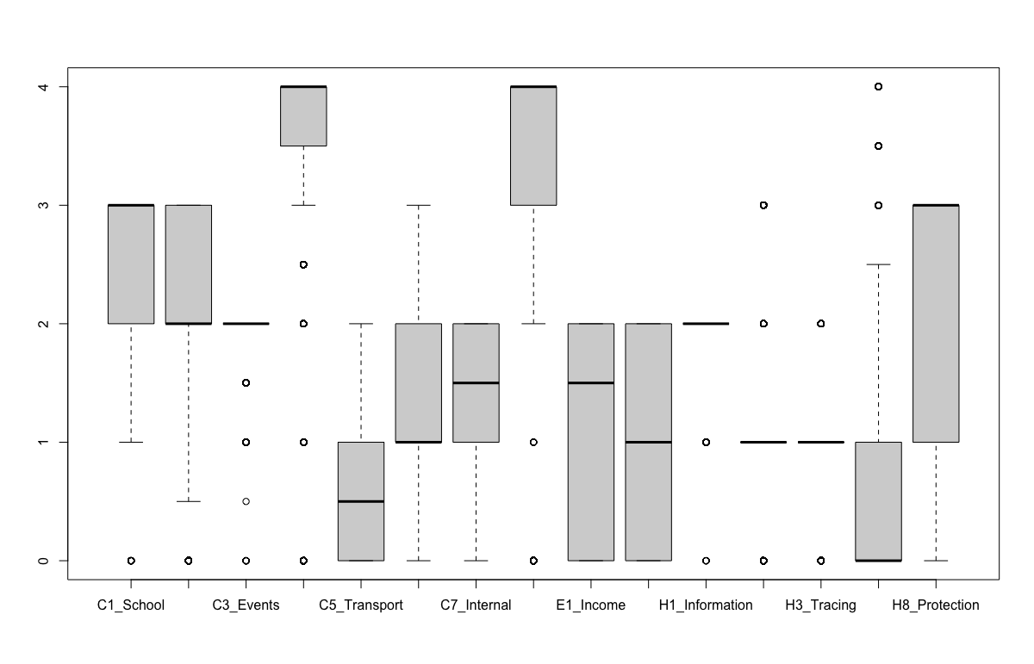
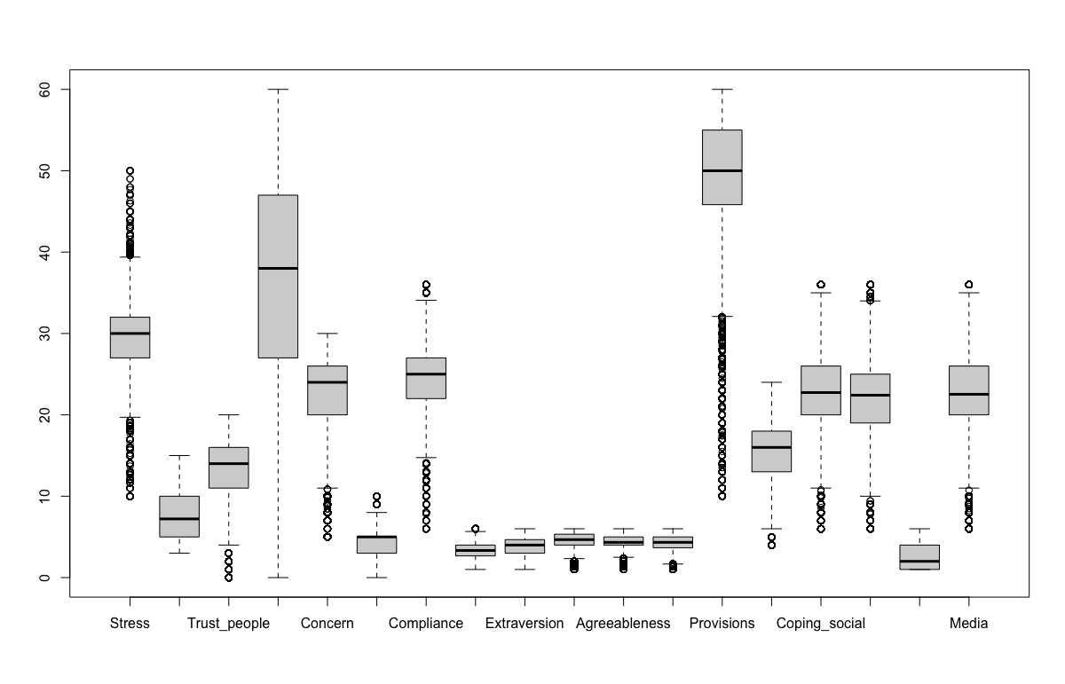
Exploratory Data Analysis

Slide 22
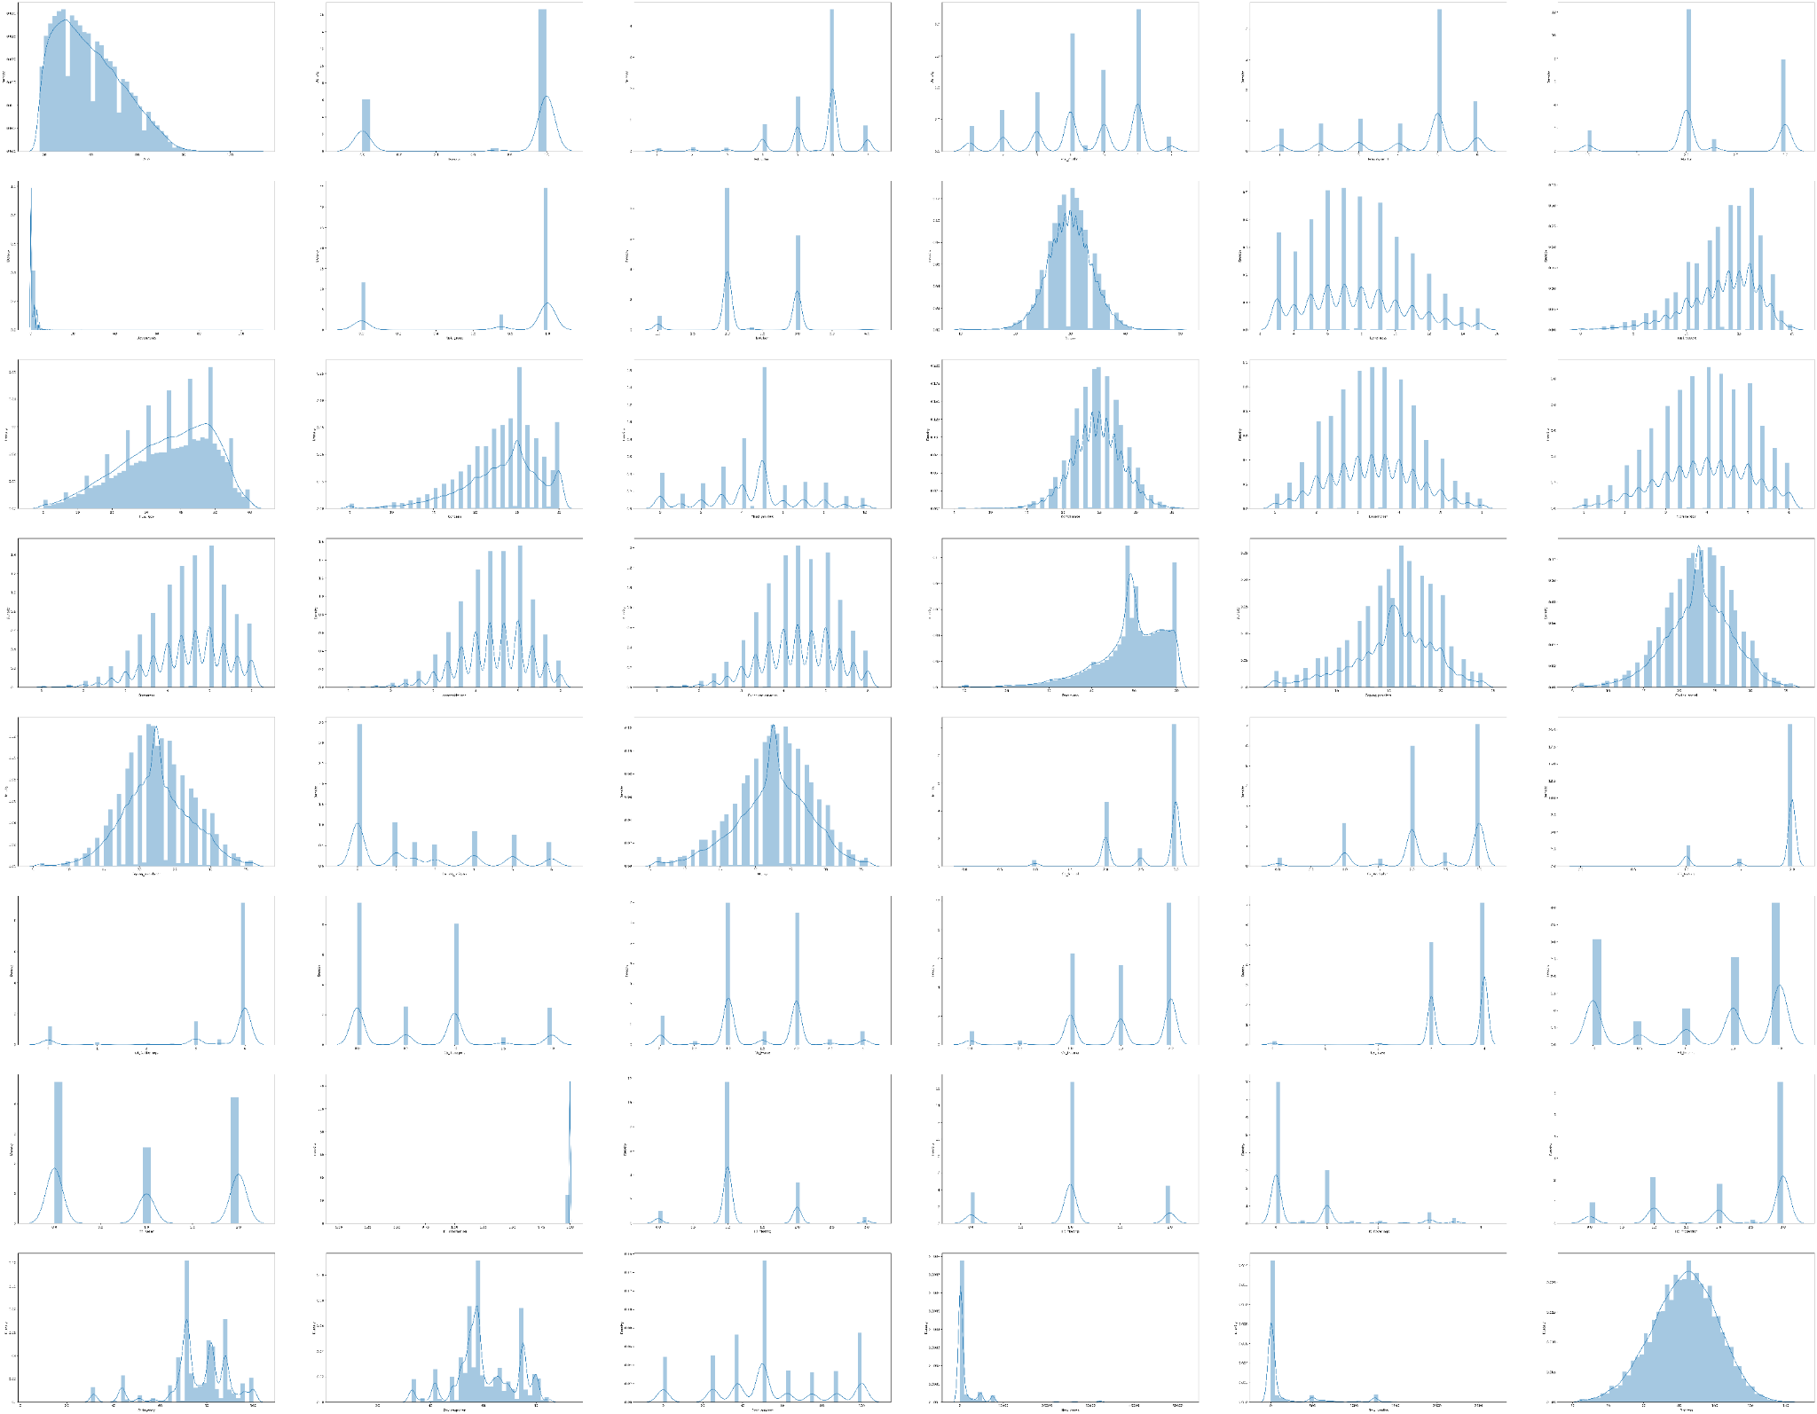
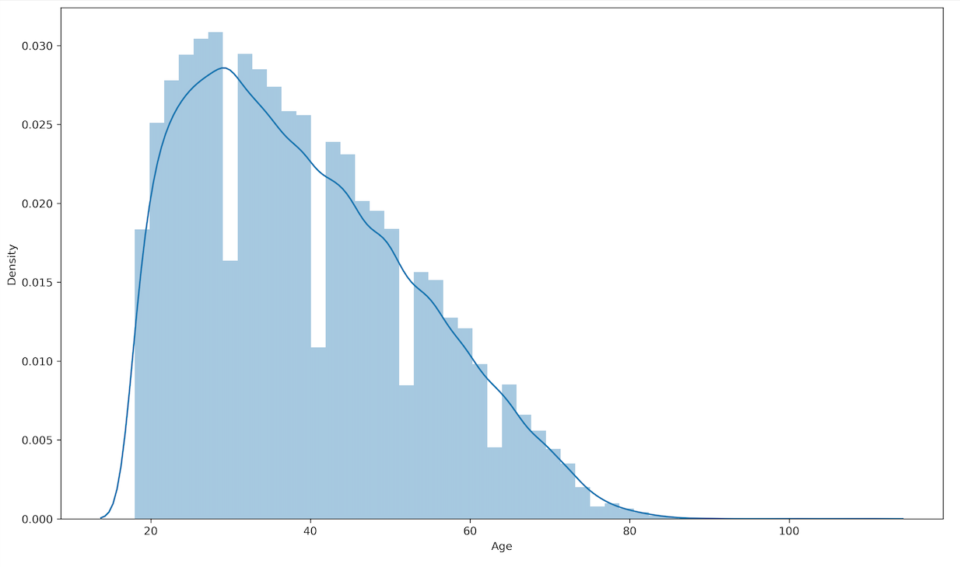
Exploratory Data Analysis
Age distribution

Slide 23
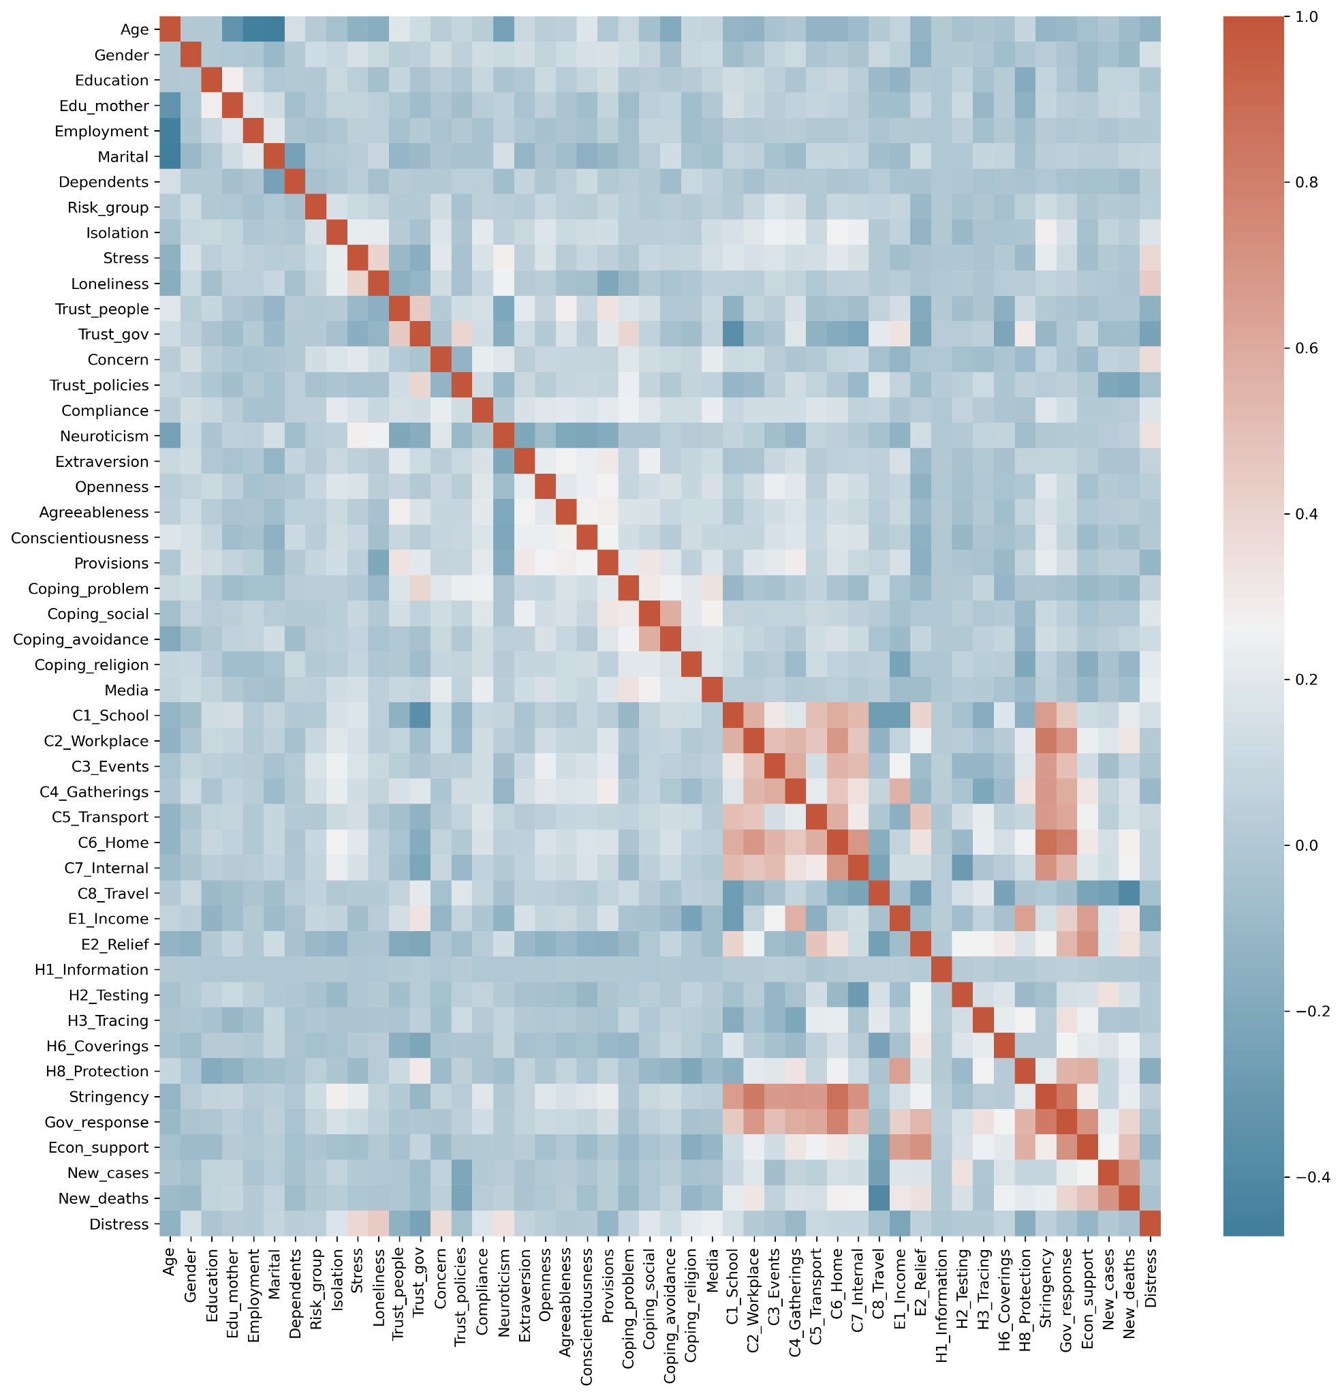
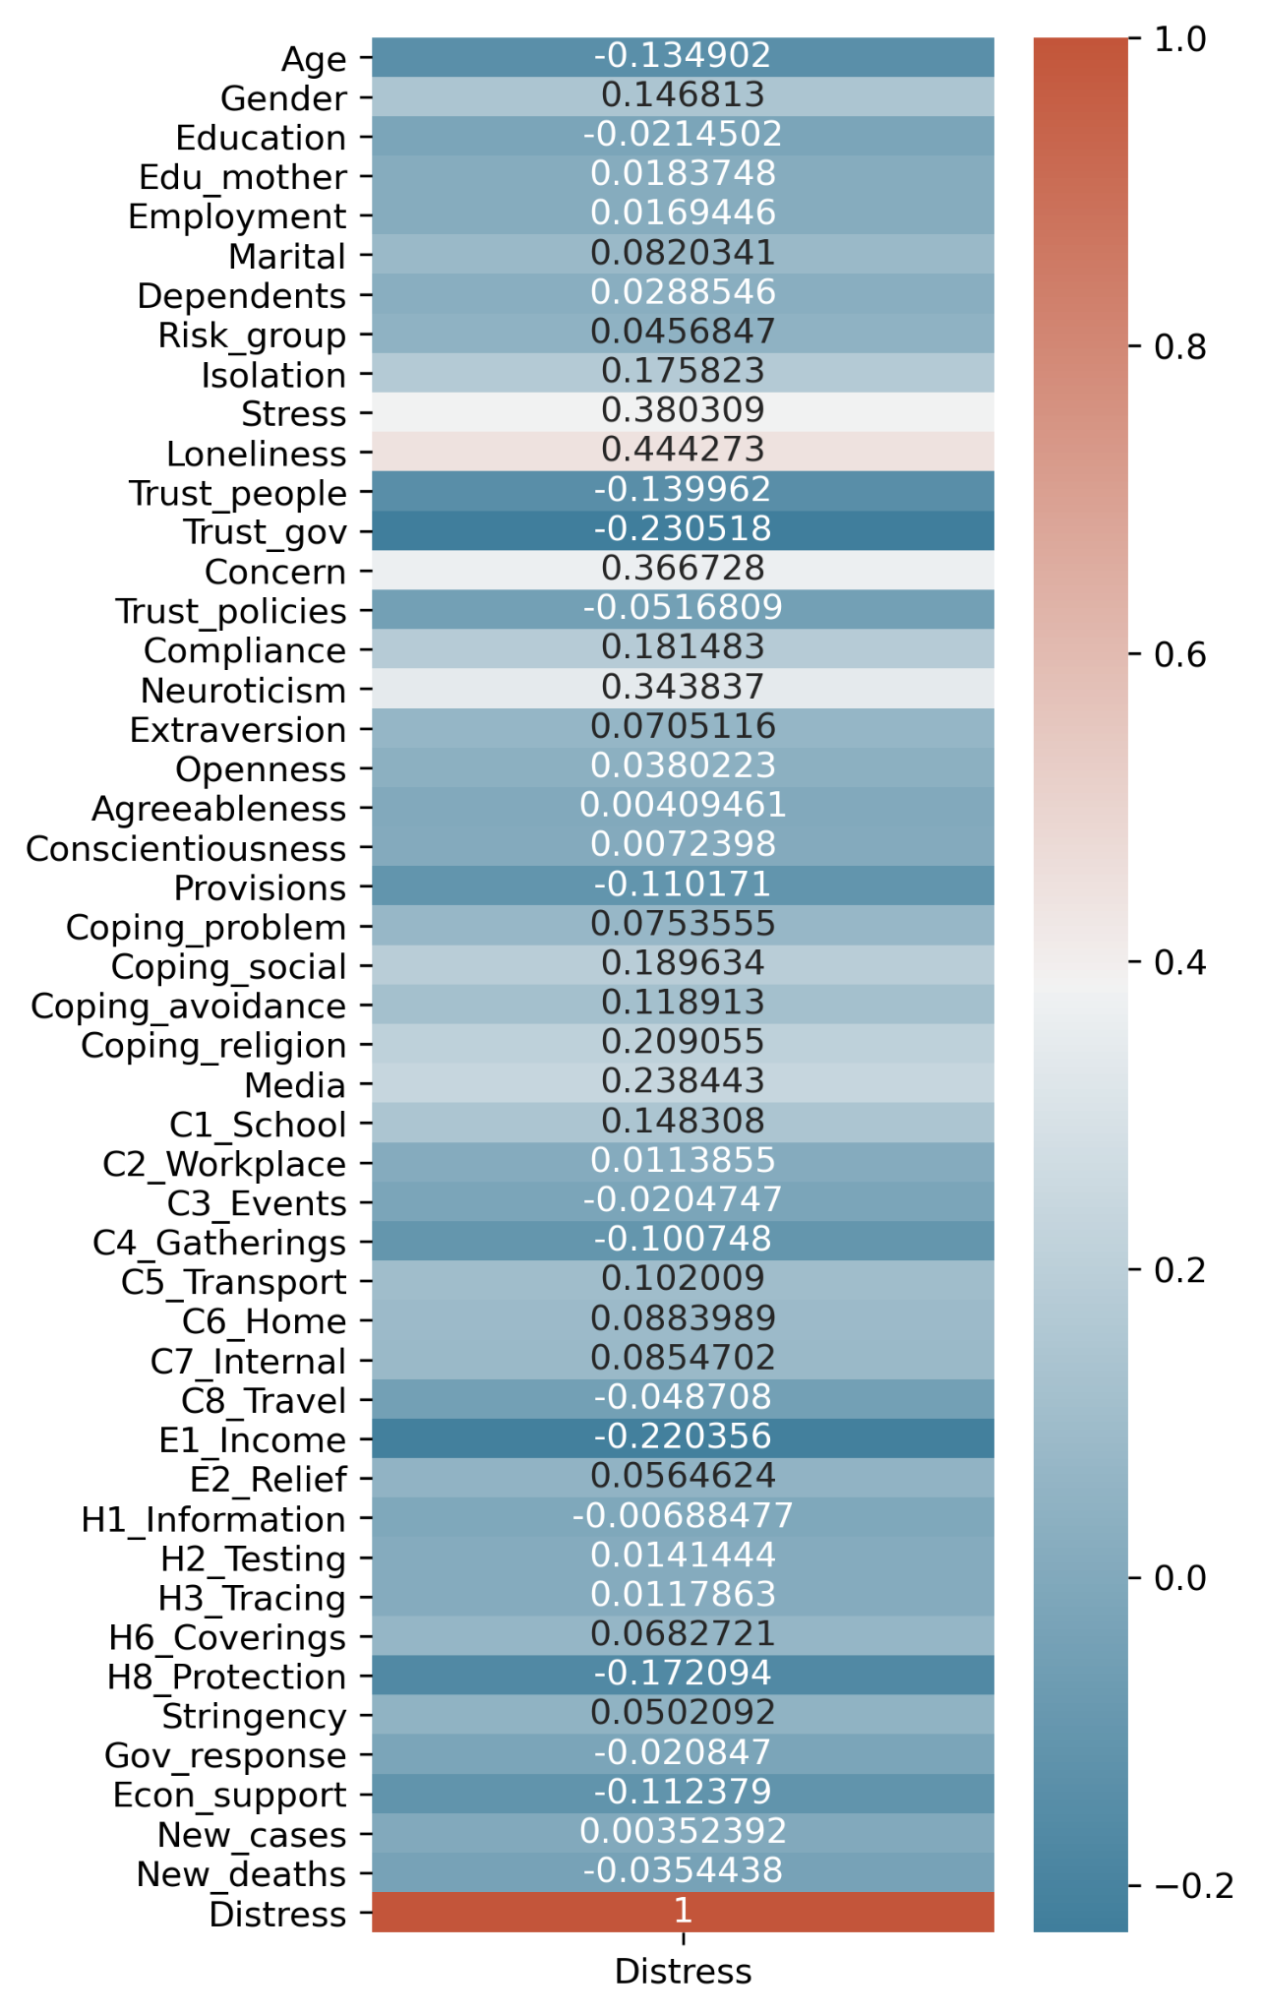
Exploratory Data Analysis

Slide 24
Data preprocessing
Filtering the period of research
Selecting interested features
Removing rows and columns > 50% NA
Replacing NA by mean
Calculating sum of features with more than one question
Adding binary flag
Filtering matched countries
Merging two datasets

Slide 25
Data preprocessing
Covid Stress
Test period: 26 - 29 March (removed)
Period: 30 March - 30 May 2020
Covid Policy
Period: 30 March - 30 May 2020
Convert confirmed cases and deaths to
New Cases
New Deaths

Slide 26
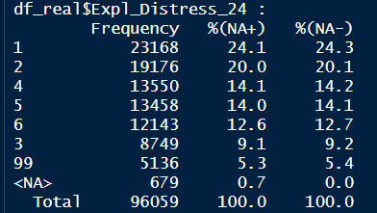
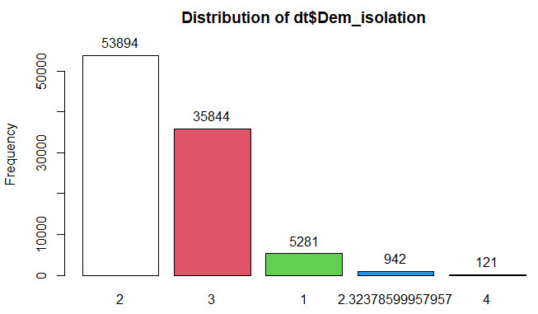
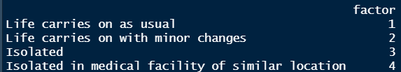
Data preprocessing
Replacing uninformative info & NA by mean
Distress (99 = “does not apply to my current situation”)
Marital status (“Uninformative info”)
Recoding textual responses into numbers

Slide 27
Merging
Removing countries with not enough info
Turkmenistan: Without no. of cases & deaths
Comorosher: Without policy data
Unmatched countries | Antigua & Barbuda | Armenia | Aruba | Bahamas | Barbados | Bermuda | Bhutan | Botswana | Burundi | Cape Verde
 | Central African Republic | Chad | Cuba | Democratic Republic of Congo | Dominica | Eswatini | Faeroe Islands | Greenlands | Grenada | Guam
 | Hong Kong | Iraq | Korea, North | Liberia | Macao | Malawi | Maldives | Micronesia, Federated States of | Mongolia | Montenegro
 | Nauru | North Macedonia | other | Palestine | Papua New Guinea | Puerto Rico | Sierra Leone | Slovakia | Syria | Tajikistan
 | Timor-Leste | Togo | Tonga | US Virgin Islands | Vanuatu | Yemen
Not enough info | Comoros | Turkmenistan

Slide 28
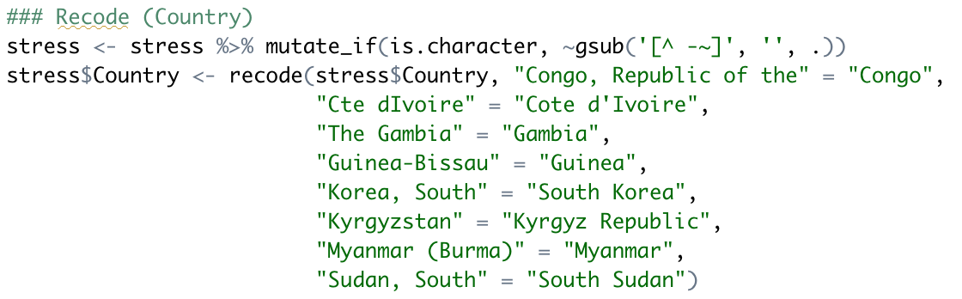
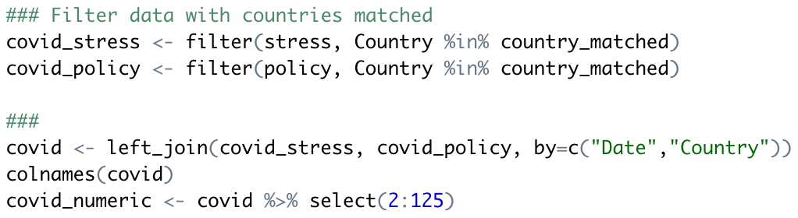
Merged Dataset
By Date & Country
Merged dataset
94,901 responses
49 features
35 Binary flags
To record NA

Slide 29
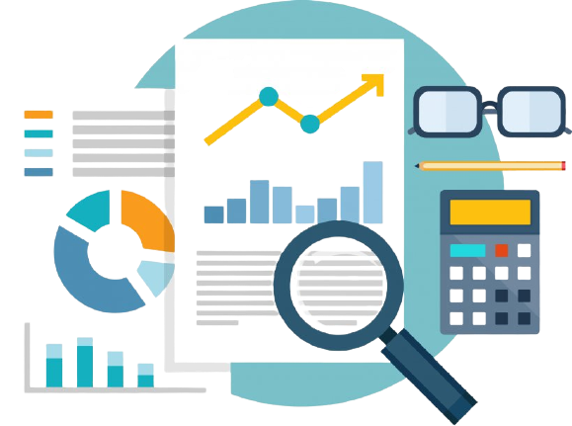
Analytical Procedure
Linear Regression
Classification And Regression Trees
Random Forest
Support Vector Machine
XGBoost

Slide 30
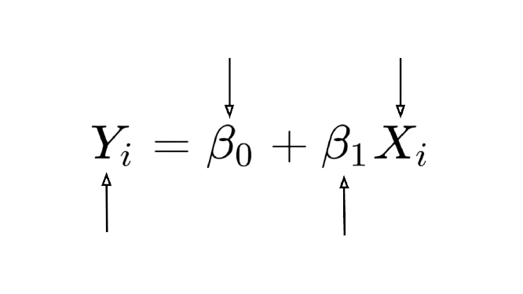
Linear Regression
one of the most commonly used predictive modelling techniques
equation can be used to predict the value of a target variable based on given predictor variable(s)
Constant/ Intercept
Independent Variable
Dependent Variable
Slope/ Coefficient

Slide 31
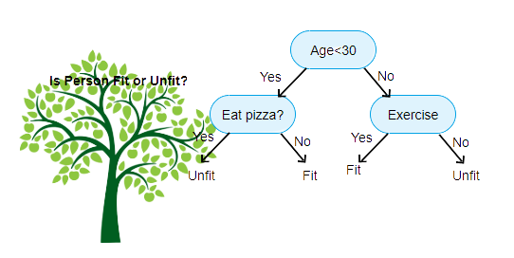
Classification And Regression Trees
a predictive algorithm
a decision tree
each fork is split in a predictor variable
each node at the end has a prediction for the target variable
how a target variable's values can be predicted based on other values

Slide 32
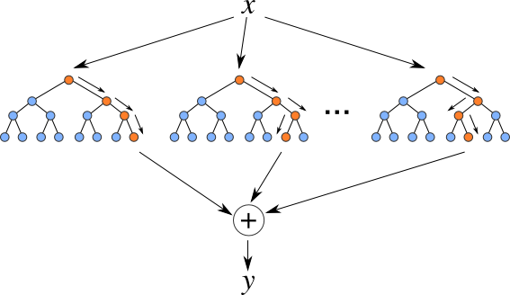
Random Forest
a classification algorithm consisting of many decisions trees
outcome based on the predictions of the decision trees
predicts by taking the average or mean of the output from various trees
↑ trees → ↑ precision of the outcome

Slide 33
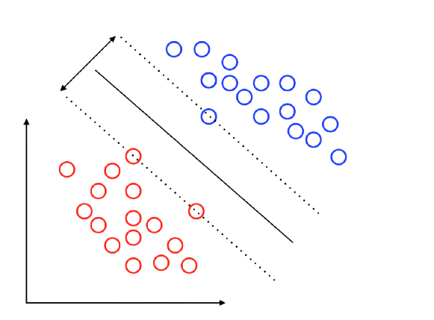
Support Vector Machine
a set of supervised learning methods
plot as a point in n-dimensional space (n = no. of features) with the value of each feature being the value of a particular coordinate
perform classification by finding the hyperplane that differentiates the two classes well
Margin
Support Vector
Decision Boundary
Support Vector

Slide 34
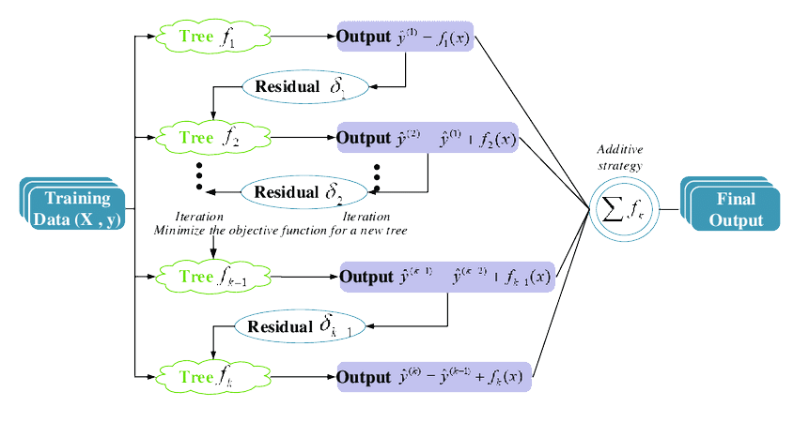
XGBoost
eXtreme Gradient Boosting
used for classification or regression predictive modeling problems
ensembles are constructed from decision tree models
loss gradient is minimized as the model is fit

Slide 35
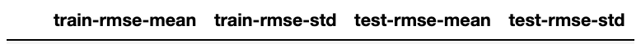
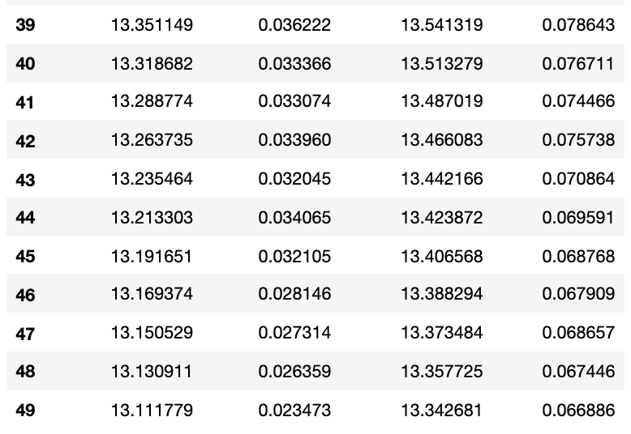
Analytical Procedure
Cross Validation
fold=10
no. of boosting trees to build = 50
Last 10 trees
Split data into
train (80%)
test (20%)
Random state = 3136
Train = 75,920
Test = 18,981
no. of trees = 50

Slide 36
03
RESULTS

Slide 37

Comparison of algorithms
 | Linear Regression | CART | Random Forest | SVM | XGBoost
MSE | 183.771 | 142479360.907 | 183.508 | 2592964.144 | 179.717
RMSE | 13.556 | 11936.472 | 13.546 | 1610.268 | 13.406
R^2 | 0.460 | -418833.656 | 0.461 | -7501.681 | 0.472

Slide 38
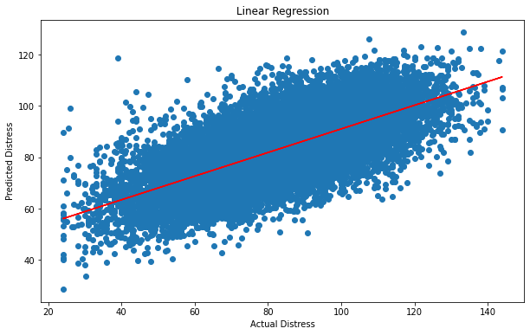
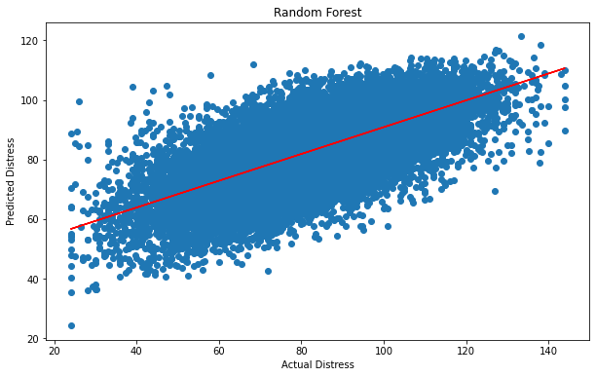
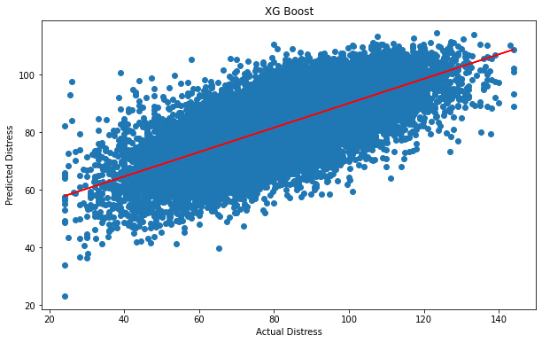
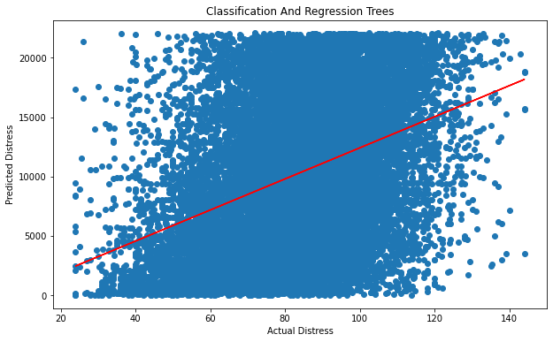
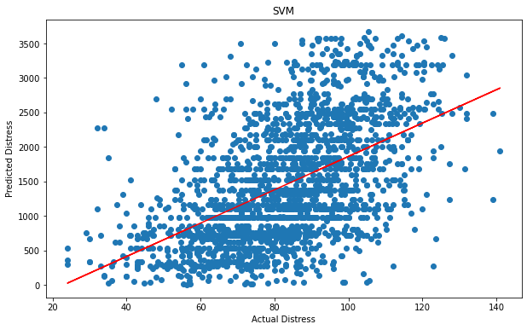
Actual Distress vs Predict Distress

Slide 39
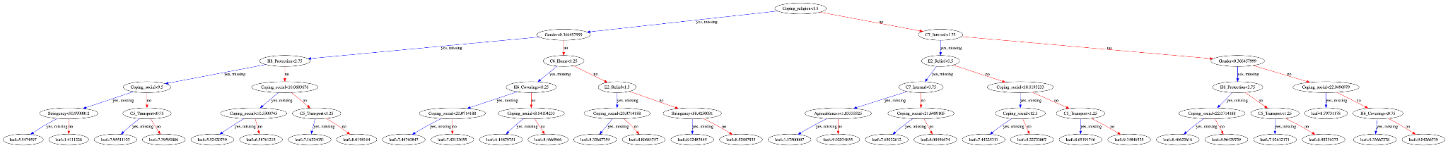
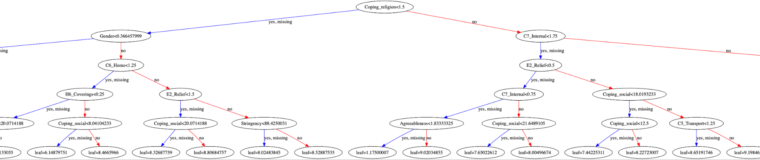
XGBoost Decision Tree
Extracted from XGBoost Decision Tree

Slide 40
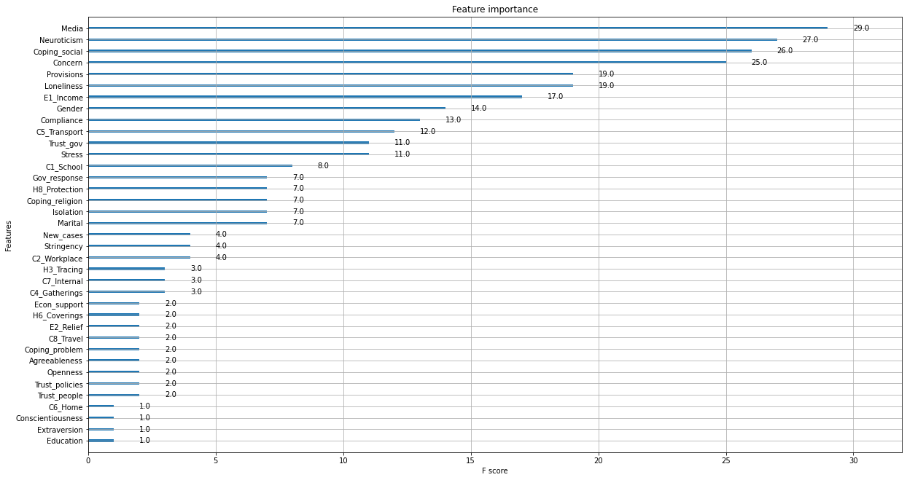
XGBoost - Features Importance

Slide 41
DISCUSSION
04
Result summary | Implications
Strengths and Limitations | Future directions

Slide 42
Result Summary (Predictors)
Top 4 Predictors with Utmost Importance
Media (1)
Neuroticism (2)
Social coping (3)
Concern over COVID-19 (4)
Hypothesis 1 is not supported. Loneliness and stress are not the best predictors of distress.
Important predictors
Stress
Loneliness
Compliance to restrictions
Gender (female)
Close public transports
Perceived social support (-ve)
Income support policy (-ve)
Trust in government (-ve)

Slide 43
Implications (Predictors)
Health anxiety
People high in neuroticism tend to be more concern over COVID-19, keep tracking COVID-related news through different media
Neurotic people have lower tolerance of stress, while the COVID news and ambiguous messages overwhelmed them which create heightened distress
Being physically and mentally bounded by COVID-19
Compliance with various guidelines and regulation will restrict access to different locations and reduce contact with other people
Less exposure to outers, reduce interpersonal communication induce loneliness, while loneliness is a significant predictor of distress and various forms of mental disturbances
Helping seeking pattern
Positive association between social coping and distress
Negative association between perceived social support and distress
People tend to seek external help when they are mentally burnt out, and cannot handle life stressors themselves, while the help seeking turns out relieve their distress

Slide 44
Results Interpretations (Model)
Fairness
No criteria based on bias
Accountability
Both primary datasets are public-available (COVIDiSTRESS and Oxford Covid-19 Government Response Tracker)
Transparency
XGBoost is relatively low in MSE (≈ 179.717), RMSE (≈ 13.406) and R^2 (≈0.472)
Notes:
Transparency - being able to query and validate predictive decisions)

Slide 45
Results Interpretations (Model)
All traditional machine learning approaches (CART and SVM) failed to compete with the linear regression model
This might be because the predictive power of machine learning methods decreased when the no. of features was prominent and the data size was relatively small

Slide 46
Implications (Model)
On such grounds, XGBoost is suggested to be adopted.
XGBoost is a machine learning algorithm contains the following features:
Clever Penalisation of Trees
A Proportional shrinking of leaf nodes
Newton Boosting
Extra Randomisation Parameter
(Gandhi, 2018)

Slide 47
Limitations
Reduced variance
NA values were replaced by mean
removed countries (e.g. Cuba, Armenia, Yemen)
Not applicable or needs justification to be partially or completely applicable
Countries or regions not included in the dataset (e.g. North Korea, Hong Kong)
Values removed or unused might also be associated with distress
For SVM, only 10000 samples were taken
Processing time
Some variables are not validated scales (e.g. distress)
Validated measurement tool for distress under COVID-19 is undeveloped
Some subnational data in OxCGRT is based on the subnations themselves

Slide 48
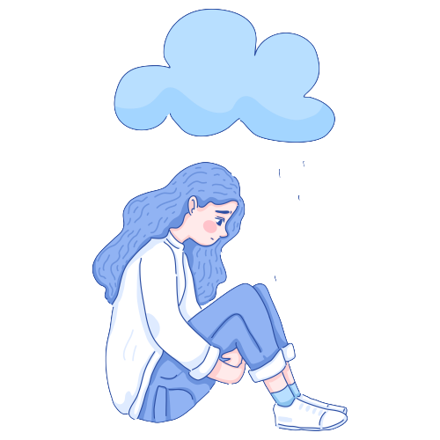
Conclusion
Top 4 Predictors with Utmost Importance
Media
Neuroticism
Social coping
Concerns over COVID-19
Top 3 Algorithm with Best Performance
XGBoost
Random Forest
Linear Regression

Slide 49
Conclusion (con’t)- Future Directions
Future studies can develop a more flexible model to predict distress, as the relationships between variables are not perfect linear.
Variables in CovidiStress are self-report data, future studies can combine objective measures, or different types of data in the predictive model
There might be mediators on the causal path between predictors and distress, future studies can take that into account to create a predictive causal pathway

Slide 50
References
Achdut, N., & Refaeli, T. (2020). Unemployment and psychological distress among young people during the COVID-19 pandemic: Psychological resources and risk factors. International Journal of Environmental Research and Public Health, 17(19), 7163. https://doi.org/10.3390/ijerph17197163
Bueno-Notivol, J., Gracia-García, P., Olaya, B., Lasheras, I., López-Antón, R., & Santabárbara, J. (2021). Prevalence of depression during the COVID-19 outbreak: A meta-analysis of community-based studies. International Journal of Clinical and Health Psychology, 21(1), 100196. https://doi.org/10.1016/j.ijchp.2020.07.007
Burke, T., Berry, A., Taylor, L. K., Stafford, O., Murphy, E., Shevlin, M., McHugh, L., & Carr, A. (2020). Increased psychological distress during COVID-19 and quarantine in ireland: A national survey. Journal of Clinical Medicine, 9(11), 3481. https://doi.org/10.3390/jcm9113481
Chao, M., Chen, X., Liu, T., Yang, H., & Hall, B. J. (2020). Psychological distress and state boredom during the COVID-19 outbreak in china: The role of meaning in life and media use. European Journal of Psychotraumatology, 11(1), 1769379. https://doi.org/10.1080/20008198.2020.1769379
Chen, F., Zheng, D., Liu, J., Gong, Y., Guan, Z., & Lou, D. (2020). Depression and anxiety among adolescents during COVID-19: A cross-sectional study. Brain, Behavior, and Immunity, 88, 36–38. https://doi.org/10.1016/j.bbi.2020.05.061
Duarte, F., & Jiménez-Molina, L. (2021). Psychological distress during the COVID-19 epidemic in chile: The role of economic uncertainty. PLOS ONE, 16(11), e0251683. https://doi.org/10.1371/journal.pone.0251683
El-Zoghby, S. M., Soltan, E. M., & Salama, H. M. (2020). Impact of the COVID-19 pandemic on mental health and social support among adult egyptians. Journal of Community Health, 45(4), 689–695. https://doi.org/10.1007/s10900-020-00853-5

Slide 51
References
Gandhi, Rohith. (2018). Gradient Boosting and XGBoost. https://medium.com/hackernoon/gradient-boosting-and-xgboost-90862daa6c77
Goodwin, R., Hou, W. K., Sun, S., & Ben-Ezra, M. (2020). Quarantine, distress and interpersonal relationships during COVID-19. General Psychiatry, 33(6), e100385. https://doi.org/10.1136/gpsych-2020-100385
Hardy, G. E., Woods, D., & Wall, T. D. (2003). The impact of psychological distress on absence from work. Journal of Applied Psychology, 88(2), 306–314. https://doi.org/10.1037/0021-9010.88.2.306
Harris, S. M., & Sandal, G. M. (2020). COVID-19 and psychological distress in norway: The role of trust in the healthcare system. Scandinavian Journal of Public Health, 49(1), 96–103. https://doi.org/10.1177/1403494820971512
Hearne, B. N. (2021). Psychological distress across intersections of race/ethnicity, gender, and marital status during the COVID-19 pandemic. Ethnicity & Health, 1–20. https://doi.org/10.1080/13557858.2021.1969537
Holingue, C., Kalb, L. G., Riehm, K. E., Bennett, D., Kapteyn, A., Veldhuis, C. B., Johnson, R. M., Fallin, M. D., Kreuter, F., Stuart, E. A., & Thrul, J. (2020). Mental distress in the united states at the beginning of the COVID-19 pandemic. American Journal of Public Health, 110(11), 1628–1634. https://doi.org/10.2105/ajph.2020.305857
Kessler, R., Andrews, G., Colpe, L., Hiripi, E., Mroczek, D., Normand, S. L., Walters, E., & Zaslavsky, A. (2002). Short screening scales to monitor population prevalences and trends in non-specific psychological distress. Psychological Medicine, 32(6), 959–976. https://doi.org/10.1017/s0033291702006074

Slide 52
References
Kowal, M., Coll‐Martín, T., Ikizer, G., Rasmussen, J., Eichel, K., Studzińska, A., Koszałkowska, K., Karwowski, M., Najmussaqib, A., Pankowski, D., Lieberoth, A., & Ahmed, O. (2020). Who is the most stressed during the COVID‐19 pandemic? Data from 26 countries and areas. Applied Psychology: Health and Well-Being, 12(4), 946–966. https://doi.org/10.1111/aphw.12234
Lechner, W. V., Laurene, K. R., Patel, S., Anderson, M., Grega, C., & Kenne, D. R. (2020). Changes in alcohol use as a function of psychological distress and social support following COVID-19 related university closings. Addictive Behaviors, 110, 106527. https://doi.org/10.1016/j.addbeh.2020.106527
Lee, R. M., Draper, M., & Lee, S. (2001). Social connectedness, dysfunctional interpersonal behaviors, and psychological distress: Testing a mediator model. Journal of Counseling Psychology, 48(3), 310–318. https://doi.org/10.1037/0022-0167.48.3.310
Liu, S., Heinzel, S., Haucke, M. N., & Heinz, A. (2021). Increased psychological distress, loneliness, and unemployment in the spread of COVID-19 over 6 months in germany. Medicina, 57(1), 53. https://doi.org/10.3390/medicina57010053
Mimoun, E., ben Ari, A., & Margalit, D. (2020). Psychological aspects of employment instability during the COVID-19 pandemic. Psychological Trauma: Theory, Research, Practice, and Policy, 12(S1), S183–S185. https://doi.org/10.1037/tra0000769
Nielsen, M. B., & Knardahl, S. (2014). Coping strategies: A prospective study of patterns, stability, and relationships with psychological distress. Scandinavian Journal of Psychology, 55(2), 142–150. https://doi.org/10.1111/sjop.12103
Nikčević, A. V., Marino, C., Kolubinski, D. C., Leach, D., & Spada, M. M. (2021). Modelling the contribution of the big five personality traits, health anxiety, and COVID-19 psychological distress to generalised anxiety and depressive symptoms during the COVID-19 pandemic. Journal of Affective Disorders, 279, 578–584. https://doi.org/10.1016/j.jad.2020.10.053

Slide 53
References
O’Hara, L., Abdul Rahim, H. F., & Shi, Z. (2020). Gender and trust in government modify the association between mental health and stringency of social distancing related public health measures to reduce COVID-19: A global online survey. MedRxiv. Published. https://doi.org/10.1101/2020.07.16.20155200
Park, C. L., Finkelstein-Fox, L., Russell, B. S., Fendrich, M., Hutchison, M., & Becker, J. (2021). Americans’ distress early in the COVID-19 pandemic: Protective resources and coping strategies. Psychological Trauma: Theory, Research, Practice, and Policy, 13(4), 422–431. https://doi.org/10.1037/tra0000931
Qiu, J., Shen, B., Wang, Z., Xie, B., & Xu, Y. (2020). Correction: A nationwide survey of psychological distress among Chinese people in the COVID-19 epidemic: implications and policy recommendations. General Psychiatry, 33(2), e100213corr1. https://doi.org/10.1136/gpsych-2020-100213corr1
Romeo, A., Benfante, A., Castelli, L., & di Tella, M. (2021). Psychological distress among italian university students compared to general workers during the COVID-19 pandemic. International Journal of Environmental Research and Public Health, 18(5), 2503. https://doi.org/10.3390/ijerph18052503
Rubin, G. J., & Wessely, S. (2020). The psychological effects of quarantining a city. BMJ, m313. https://doi.org/10.1136/bmj.m313
Saltzman, L. Y., Hansel, T. C., & Bordnick, P. S. (2020). Loneliness, isolation, and social support factors in post-COVID-19 mental health. Psychological Trauma: Theory, Research, Practice, and Policy, 12(S1), 55–57. https://doi.org/10.1037/tra0000703
Santabárbara, J., Lasheras, I., Lipnicki, D. M., Bueno-Notivol, J., Pérez-Moreno, M., López-Antón, R., de la Cámara, C., Lobo, A., & Gracia-García, P. (2021). Prevalence of anxiety in the COVID-19 pandemic: An updated meta-analysis of community-based studies. Progress in Neuro-Psychopharmacology and Biological Psychiatry, 109, 110207. https://doi.org/10.1016/j.pnpbp.2020.110207

Slide 54
References
Sibley, C. G., Greaves, L. M., Satherley, N., Wilson, M. S., Overall, N. C., Lee, C. H. J., Milojev, P., Bulbulia, J., Osborne, D., Milfont, T. L., Houkamau, C. A., Duck, I. M., Vickers-Jones, R., & Barlow, F. K. (2020). Effects of the COVID-19 pandemic and nationwide lockdown on trust, attitudes toward government, and well-being. American Psychologist, 75(5), 618–630. https://doi.org/10.1037/amp0000662
Siebenhaar, K. U., Köther, A. K., & Alpers, G. W. (2020). Dealing with the COVID-19 infodemic: Distress by information, information avoidance, and compliance with preventive measures. Frontiers in Psychology, 11. https://doi.org/10.3389/fpsyg.2020.567905
Szkody, E., Stearns, M., Stanhope, L., & McKinney, C. (2020). Stress‐Buffering role of social support during COVID‐19. Family Process, 60(3), 1002–1015. https://doi.org/10.1111/famp.12618
Thompson Jr., R. J., Merritt, K. A., Keith, B. R., Murphy, L. B., & Johndrow, D. A. (1993). The role of maternal stress and family functioning in maternal distress and Mother-Reported and Child-Reported psychological adjustment of nonreferred children. Journal of Clinical Child Psychology, 22(1), 78–84. https://doi.org/10.1207/s15374424jccp2201_8
Varma, P., Junge, M., Meaklim, H., & Jackson, M. L. (2021). Younger people are more vulnerable to stress, anxiety and depression during COVID-19 pandemic: A global cross-sectional survey. Progress in Neuro-Psychopharmacology and Biological Psychiatry, 109, 110236. https://doi.org/10.1016/j.pnpbp.2020.110236
Wang, C., Pan, R., Wan, X., Tan, Y., Xu, L., Ho, C. S., & Ho, R. C. (2020). Immediate psychological responses and associated factors during the initial stage of the 2019 coronavirus disease (COVID-19) epidemic among the general population in china. International Journal of Environmental Research and Public Health, 17(5), 1729. https://doi.org/10.3390/ijerph17051729

Slide 55
References
Wells, J. D., Hobfoll, S. E., & Lavin, J. (1999). When it rains, it pours: The greater impact of resource loss compared to gain on psychological distress. Personality and Social Psychology Bulletin, 25(9), 1172–1182. https://doi.org/10.1177/01461672992512010
Wheaton, M. G., Messner, G. R., & Marks, J. B. (2021). Intolerance of uncertainty as a factor linking obsessive-compulsive symptoms, health anxiety and concerns about the spread of the novel coronavirus (COVID-19) in the united states. Journal of Obsessive-Compulsive and Related Disorders, 28, 100605. https://doi.org/10.1016/j.jocrd.2020.100605
Yang, Q., Xu, S., Cao, B., Zhang, Y., Ni, C., & Shang, J. (2009). Study on the correlation between interpersonal trust and the social avoidance and distress in nursing and medical students. Journal of Nursing Science, 15.
Zheng, J., Morstead, T., Sin, N., Klaiber, P., Umberson, D., Kamble, S., & DeLongis, A. (2021). Psychological distress in north america during COVID-19: The role of pandemic-related stressors. Social Science & Medicine, 270, 113687. https://doi.org/10.1016/j.socscimed.2021.113687

Slide 56
THANKS!

